Slide 1
Understanding MYP Final Report Cards
Assunta Budd: MYP Coordinator
Notes:
Introduction : Ian, context of change and the process, link to new Reporting/draft order for K-9

Slide 2
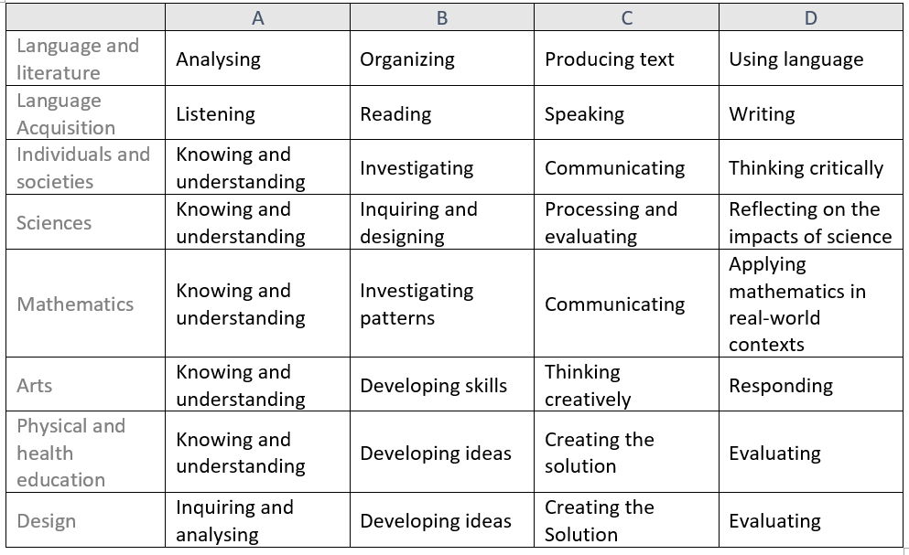
MYP uses standard based assessment.
Each subject has standards grouped into four Criteria (A-D). Grade 8 has all 8 subjects use MYP assessment. Grade 9 and 10 have 6 out of the 8 subjects use MYP assessment (report cards for Arts and Design 9/10 can be found in the second link in MyClass).
MYP Assessment
Criteria
Subject
Notes:
Assunta

Slide 3
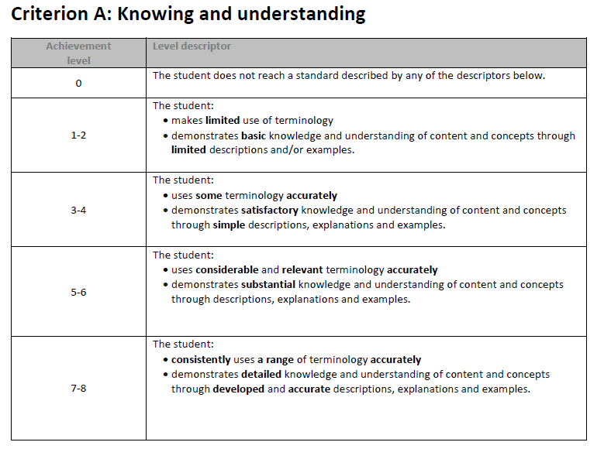
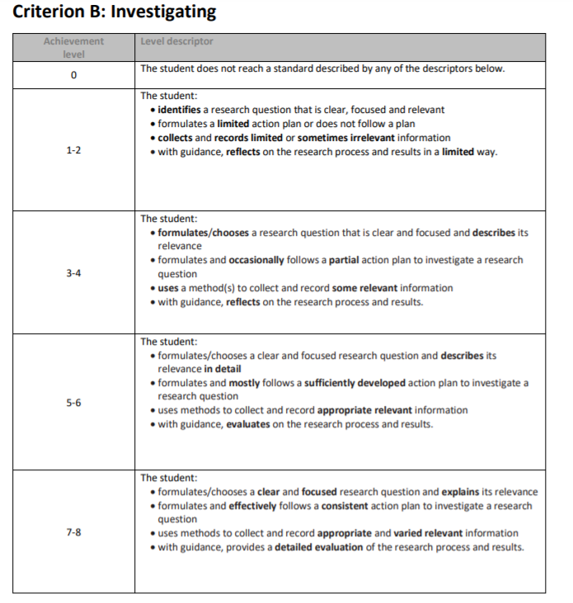
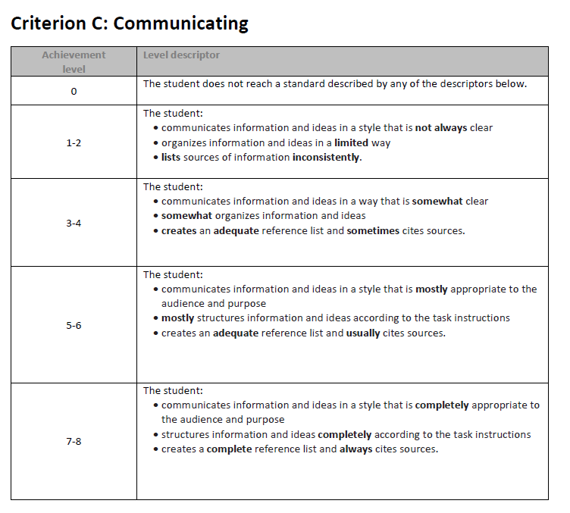
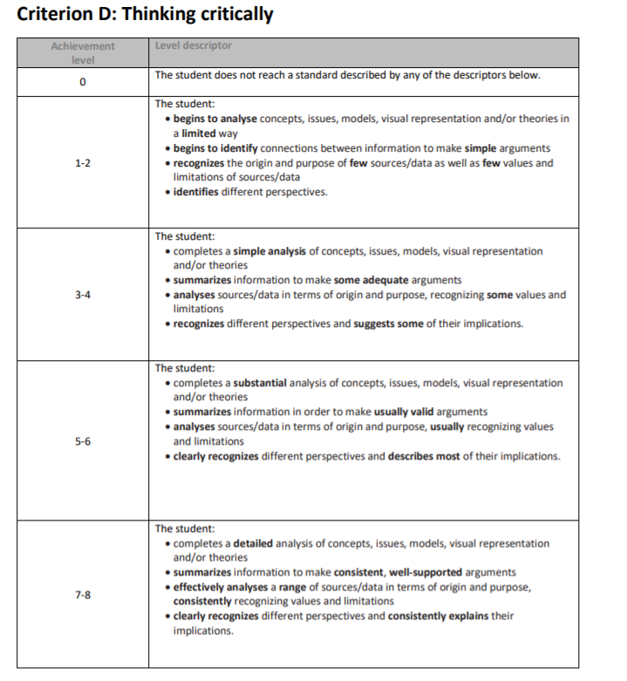
MYP Assessment Rubrics- ex Individuals and Societies
Each subject’s Criteria A- D has a rubric with achievement levels from 0-8. ( Full rubrics are found online on GSS website : IB Programme,
MYP Program, MYP rubrics -password: gssparent)
Notes:
Assunta

Slide 4
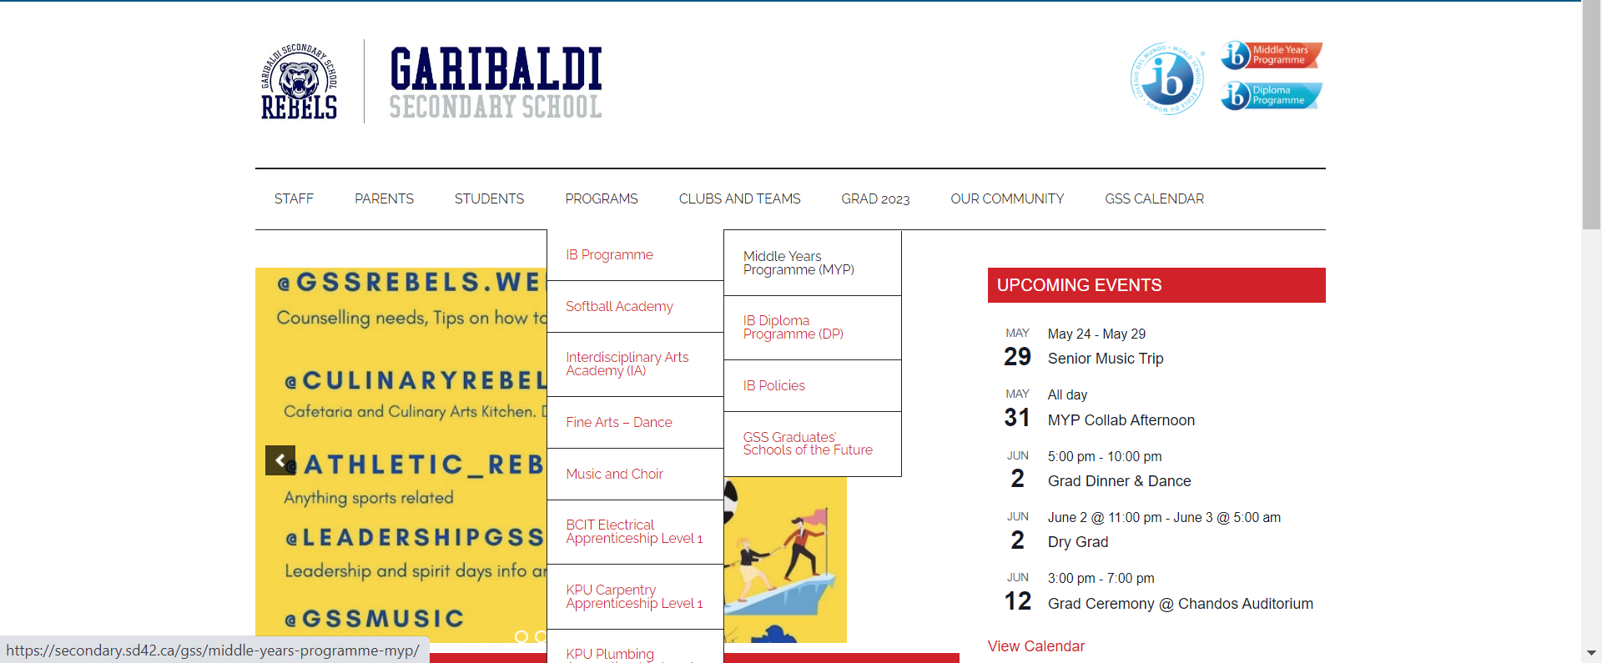
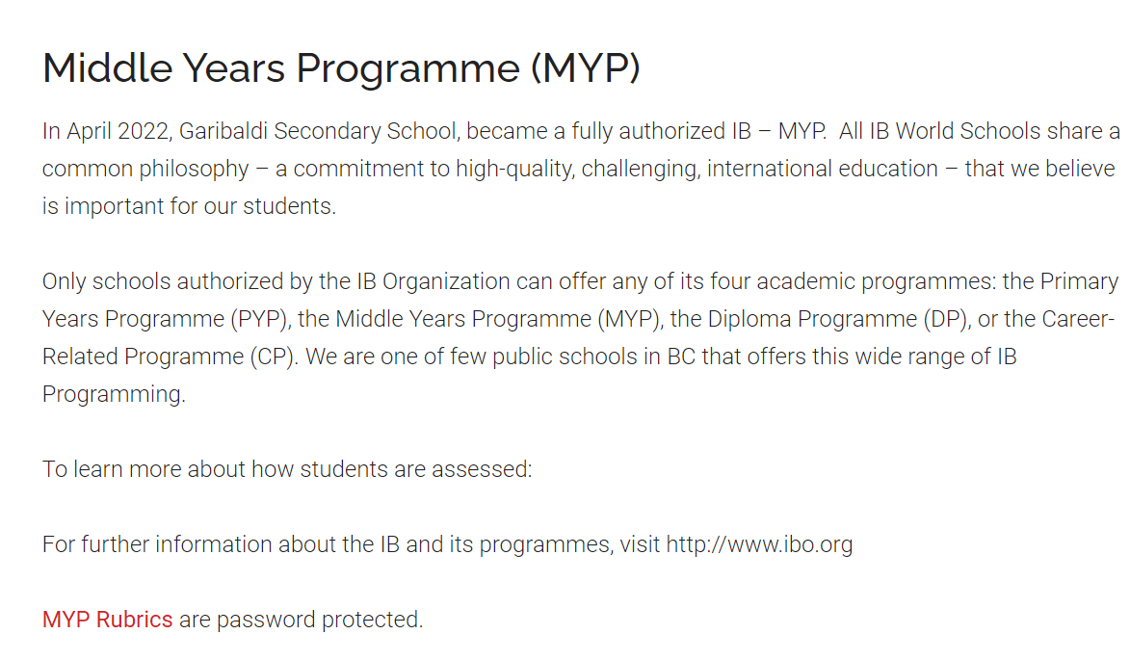
Full rubrics posted….(password : gssparent)
Notes:
Assunta

Slide 5
What do the different levels of achievement mean?
Emerging | Level 0 | The student has not submitted work and/or the student does not reach a standard described by the descriptors of the MYP criteria.
 | Level 1-2 | The student demonstrates an initial understanding of the concepts and competencies relevant to the expected learning.
Developing | Level 3 - 4 | The student demonstrates a partial understanding of the concepts and competencies relevant to the expected learning.
Proficient | Level 5 - 6 | The student demonstrates a complete understanding of the concepts and competencies relevant to the expected learning.
Extending | Level 7 - 8 | The student demonstrates a sophisticated understanding of the concepts and competencies relevant to the expected learning.
*Note that a 4 on the above chart is not equivalent to 50%, but rather indicates that the student is meeting the expectations for the course.*
Notes:
Helen

Slide 6
Report cards will show a score out of 8 for each MYP Criteria A -D.
Report cards will NOT show an Overall Achievement level on the 1-7 scale. but it can be determined from the IB conversion chart on the next slide
MYP Final Report Cards
Notes:
Example of Fine Arts 9: Drama/ Art and Design 9:
Cooking, woodworking, coding ?

Slide 7
Example Final Report Card
MYP – Individuals & Societies | Absent
Teacher: | Late
Criterion
A: Knowing & understanding | 4
i. uses some terminology accurately ii. demonstrates satisfactory knowledge and understanding of content and concepts through simple descriptions, explanations and examples
B: Investigating | 5
i. formulates/chooses a clear and focused research question and describes its relevance in detail ii. formulates and mostly follows a sufficiently developed action plan to investigate a research question iii. uses methods to collect and record appropriate relevant information iv. with guidance, evaluates on the research process and results.
C: Communicating | 3
i. communicates information and ideas in a way that is somewhat appropriate to the audience and purpose ii. somewhat organizes information and ideas iii. creates an adequate reference list and sometimes cites sources.
D: Thinking critically | 2
i. completes a suitable analysis of concepts, issues, models, visual representation and/or theories ii. summarizes information in order to make usually valid arguments iii. analyses sources/data in terms of origin and purpose, usually recognizing value and limitations iv. clearly recognizes different perspectives and describes most of their implications.
Overall Level of Achievement ( 1- 7 IB scale)
Teacher comments go here
Each criteria is assessed using the 1-8 scale.
For this final report card we will NOT have an Overall Level of Achievement calculated on the subject pages.
To determine the Overall Level of Achievement on the IB 1 -7 scale, the values for the four criteria A – D can be totaled and an overall score from can be determined from the chart below.
For this student 4+5+3+2=14. Overall on the 1- 7 scale the student has a 3. This student is developing and has a partial understanding of concepts and curricular competencies.
*NEW
IB 1-7 Overall Achievement levels | 1 | 2 | 3 | 4 | 5 | 6 | 7
Criterion boundaries (score out of /32) | 1-5 | 6-9 | 10-14 | 15-18 | 19-23 | 24-27 | 28-32
*
Notes:
Remember to say that if you child has not handed work in, one of the criteria would not be filled in. In the comment section, the teacher would indicate that the student has an I and that they need to complete a specific task or set of tasks by a specific time frame. Overall level of Achievement is blank Assunta

Slide 8
Grade 8 ROTATION ONLY Report Card
Fine Arts 8* and Design 8* courses are rotations. Students participate in more than one stream. Not all criteria will be assessed in each subject for each rotation because of time constraints.
Only criteria that have been assessed during the rotation will have an achievement level.
This example report card indicates the student is developing and has a partial understanding of content and curricular competencies.
*Career Education 8, Design and Technology 8, Textiles and Food studies 8, Digital coding and Media 8, Career education 8, Drama 8, Visual Arts 8, Music 8 Guitar
MYP - Design Wood and Metal Work | Absent
Teacher: | Late
Criterion
A : Inquiring and analysing
B: Developing Ideas
C: Creating the solution | 3
i. Outlines each step in a plan that contains some details, resulting in peers having difficulty following the plan to create a solution ii. Demonstrates satisfactory technical skills when making the solution Iii. creates the solution, which partially functions and is adequately presented Iv. outlines changes made to the chosen design iii. creates an adequate reference list and sometimes cites sources.
D: Evaluating
Overall Level of Achievement
Teacher comments can go here...
Notes:
Helen

Slide 9
Grade 10 ONLY
MYP – Individuals & Societies | Absent
Teacher: | Late
Criterion
A: Knowing & understanding | 2
i. Uses limited relevant terminology Demonstrates basic knowledge and understanding of content and concepts with minimal descriptions and/or examples.
B: Investigating | 1
i. Formulates a research question that is clear or focused and describes its relevance ii. Formulates a limited action plan to investigate a research question or does not follow a plan iii. Collects and records limited information, not always consistent with the research question iv. Makes a limited evaluation of the process and results of the investigation
C: Communicating | 3
i. Communicates information and ideas satisfactorily by using a style that is somewhat appropriate to the audience and purpose ii. Structures information and ideas in a way that is somewhat appropriate to the specified format iii. Sometimes documents sources of information using a recognized convention.
D: Thinking critically | 2
i. Analyses concepts, issues, models, visual representation and theories to a limited extent ii. Summarizes information to a limited extent to make arguments iii. Describes a limited number of sources/data in terms of origin and purpose and recognizes nominal value and limitations iv. Identifies different perspectives and minimal implications
Overall Level of Achievement ( 1- 7 IB scale)
Teacher comments go here
To receive graduation credit for a Grade 10 course, a student needs to have a total score of 8 (add the 4 Criteria scores together).
Notes:
Remember to say that if you child has not handed work in, one of the criteria would not be filled in. In the comment section, the teacher would indicate that the student has an I and that they need to complete a specific task or set of tasks by a specific time frame. Overall level of Achievement is blank Assunta

Slide 10
MYP coordinator
Assunta Budd: abudd@sd42.ca
Need more information about MYP?
Notes:
Assunta

